Slide 1
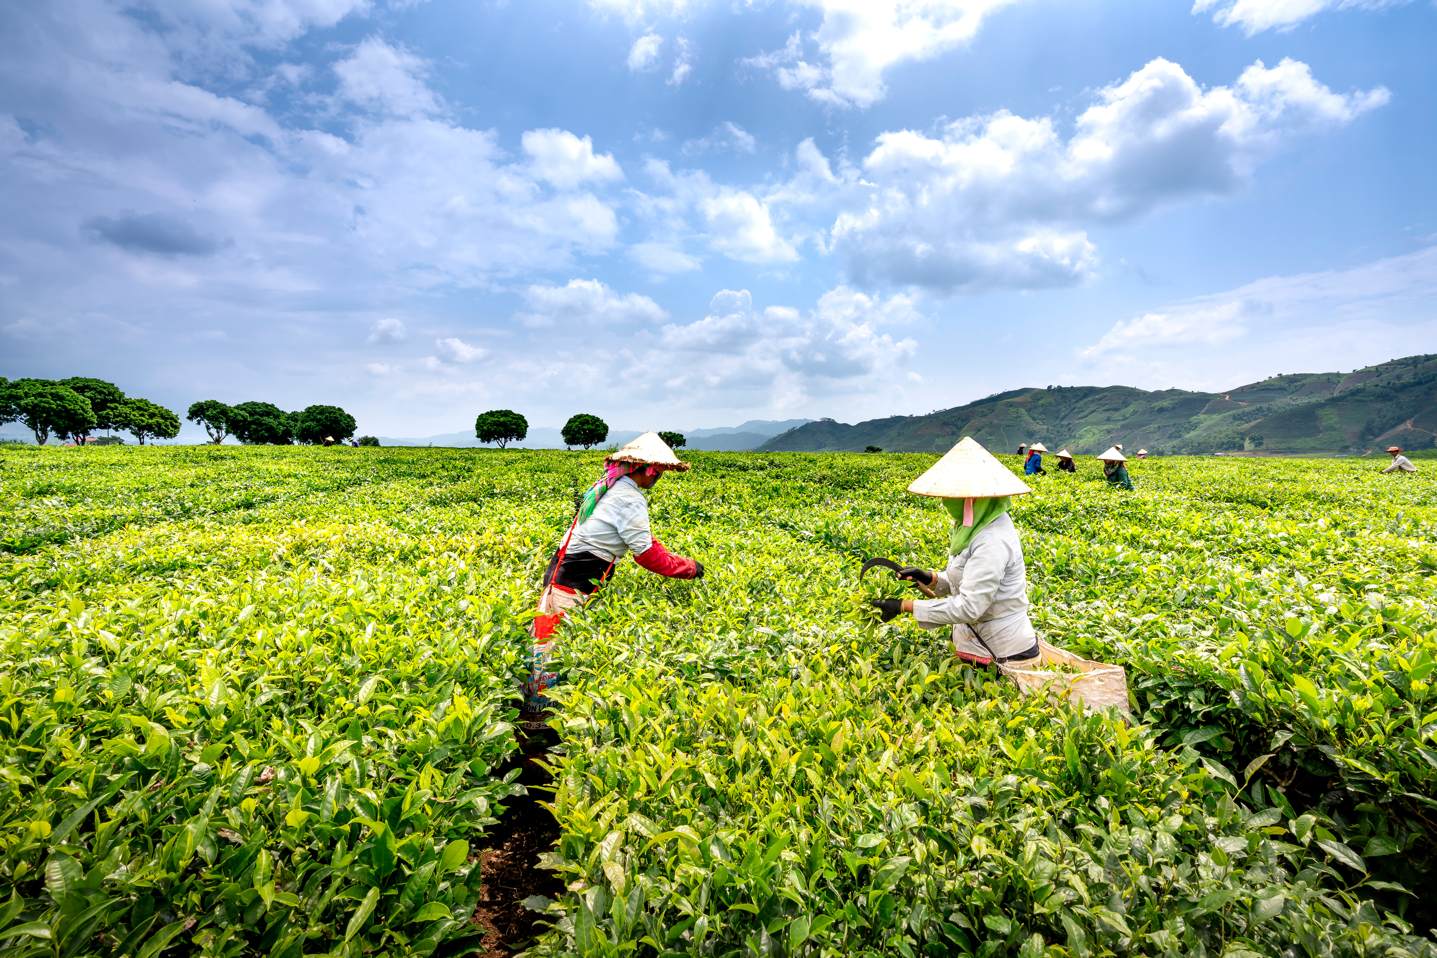



Gandhi Institute For Technology, Bhubaneswar
Smart Farming Made Easy
FarmSathi
Optimize Farming with AI Smart crop and fertilizer recommendations for better yields.
Mohanty Hitesh Rabindranath
Syed Sadiqu Hussain
B.Tech(CSE)

Slide 2
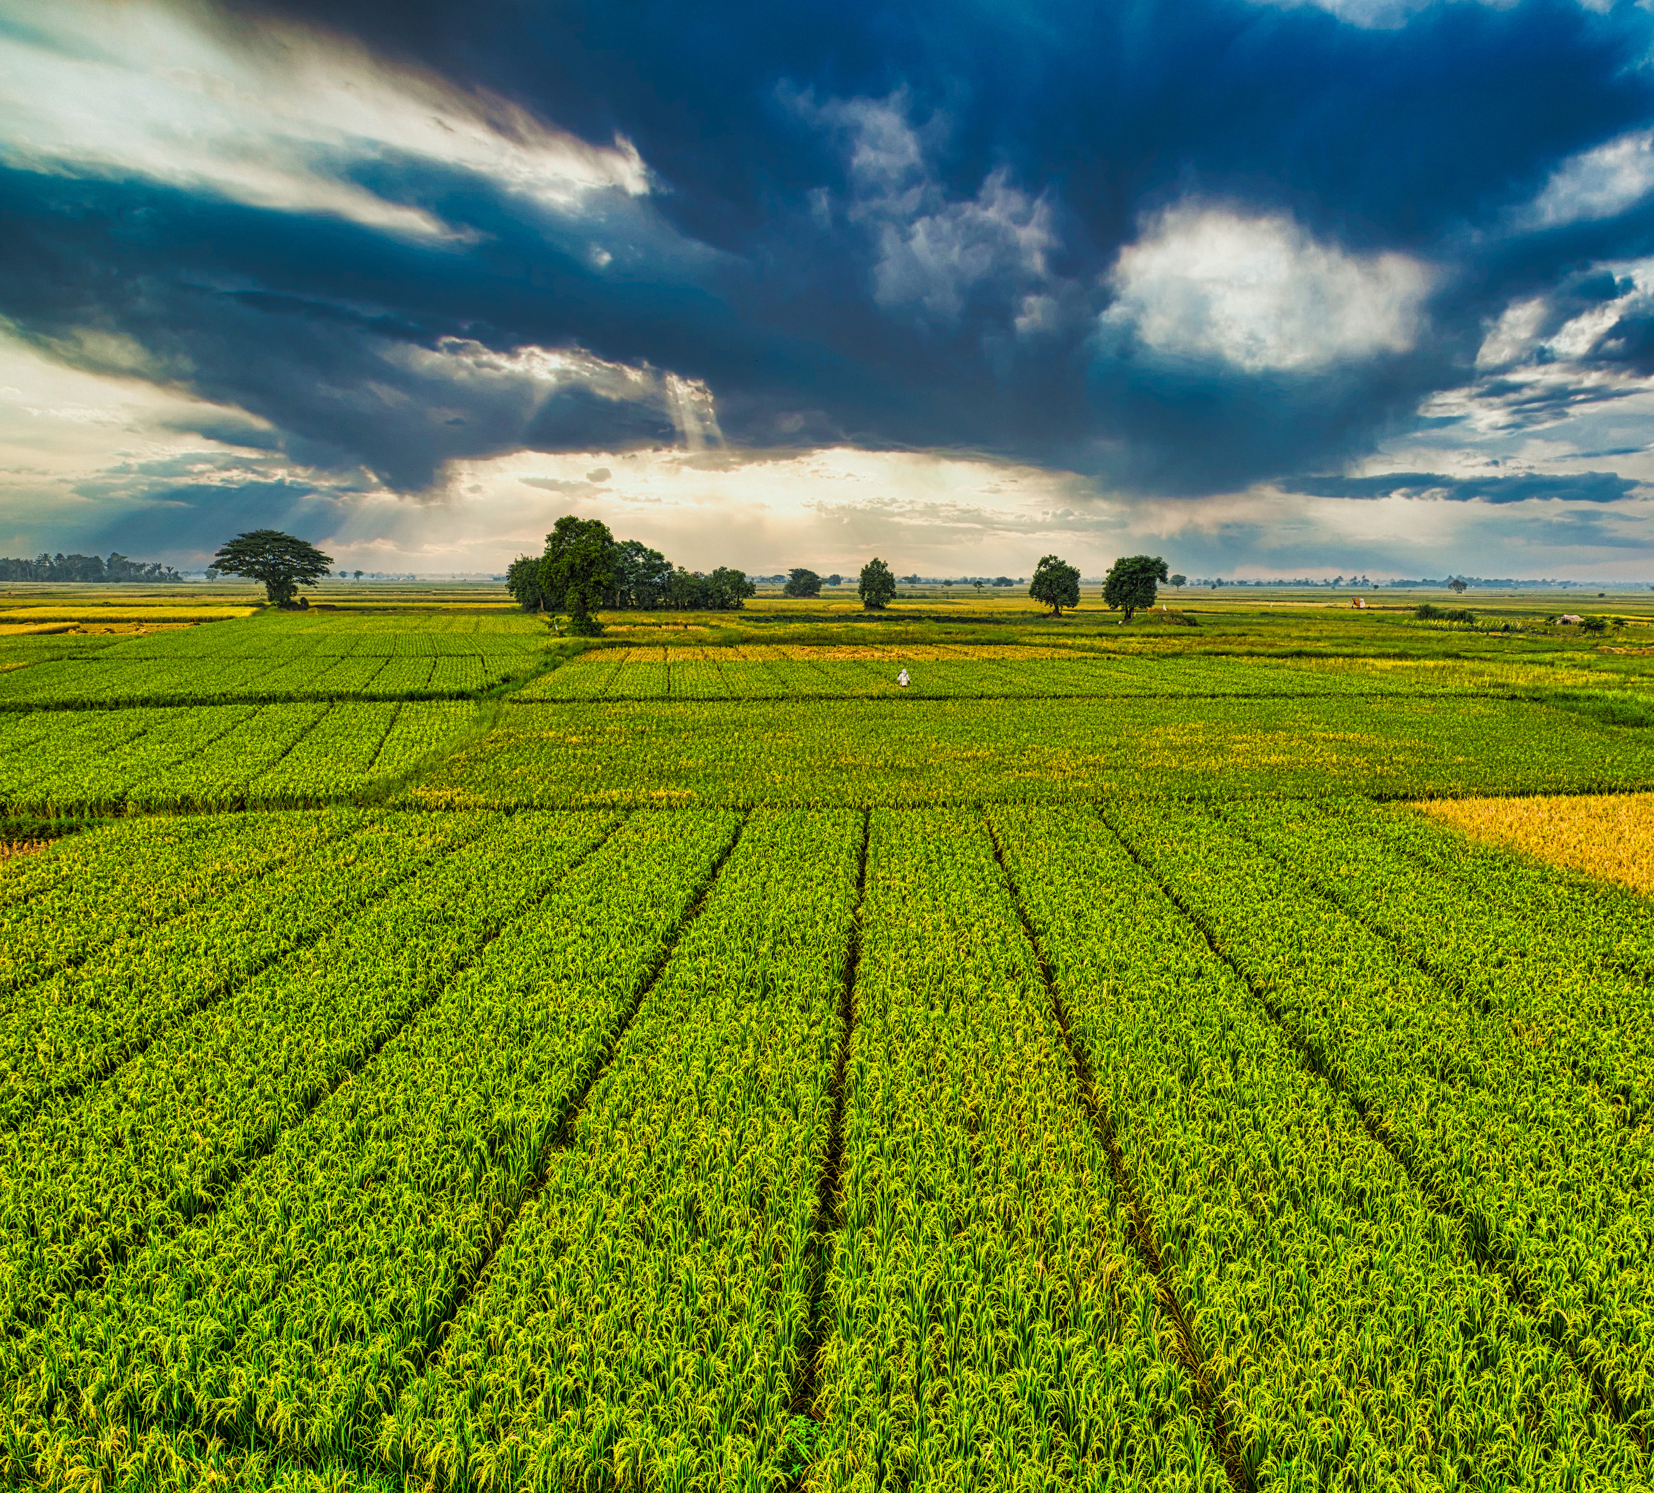

Introduction
Overview:
This project aims to help farmers make data-driven decisions on crop selection and fertilizer usage through an AI-powered web app.
Purpose:
The model provides personalized crop and fertilizer recommendations based on environmental factors, ensuring better productivity and sustainable farming practices.

Slide 3
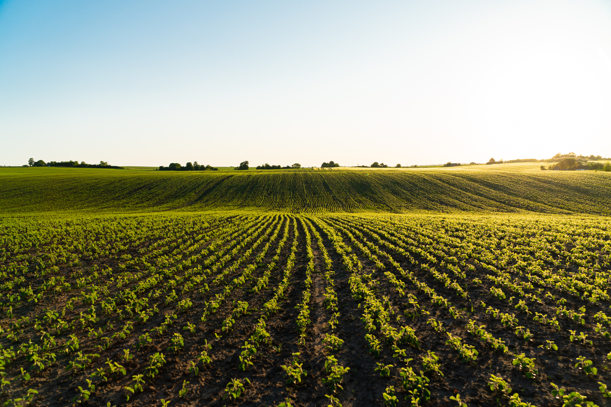

Problem Statement
Challenge:
Solution:
Farmers often struggle to select the right crop and fertilizer due to varying soil types, climate, and other factors, leading to reduced yields and inefficient resource utilization.
An AI-driven system that analyzes these factors and provides recommendations to optimize crop growth and fertilizer use.

Slide 4
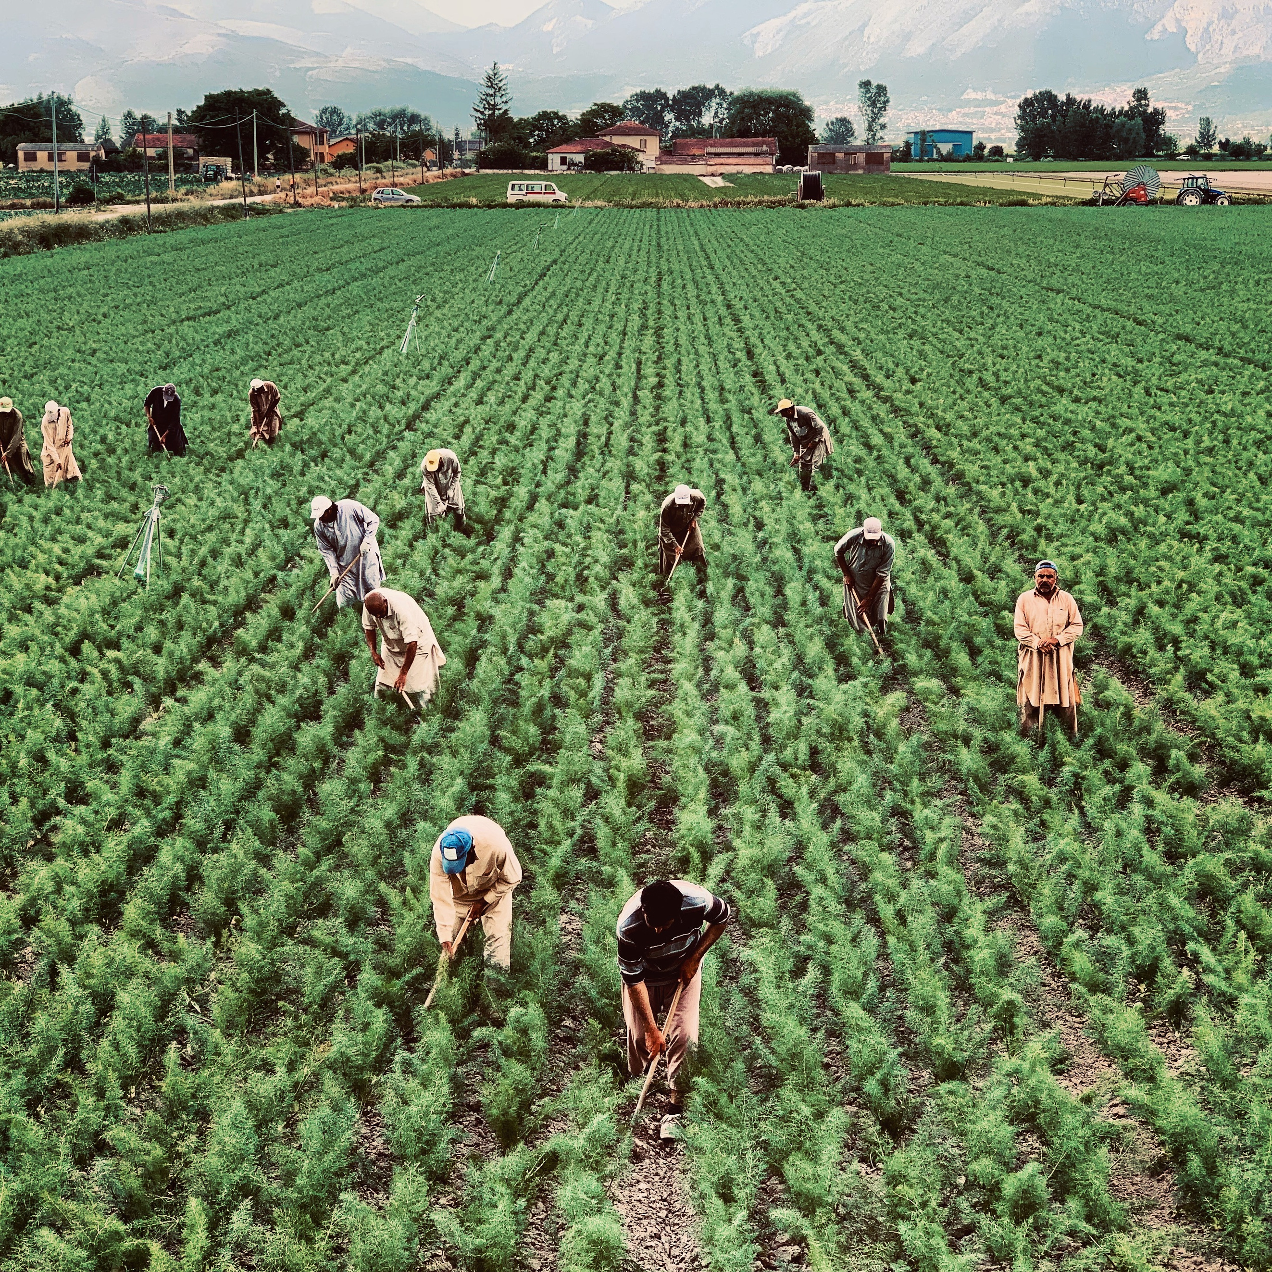

Development Workflow
01
Data Collection
02
Model Selection and Training
03
Model Testing and Evaluation
04
Model Deployment

Slide 5
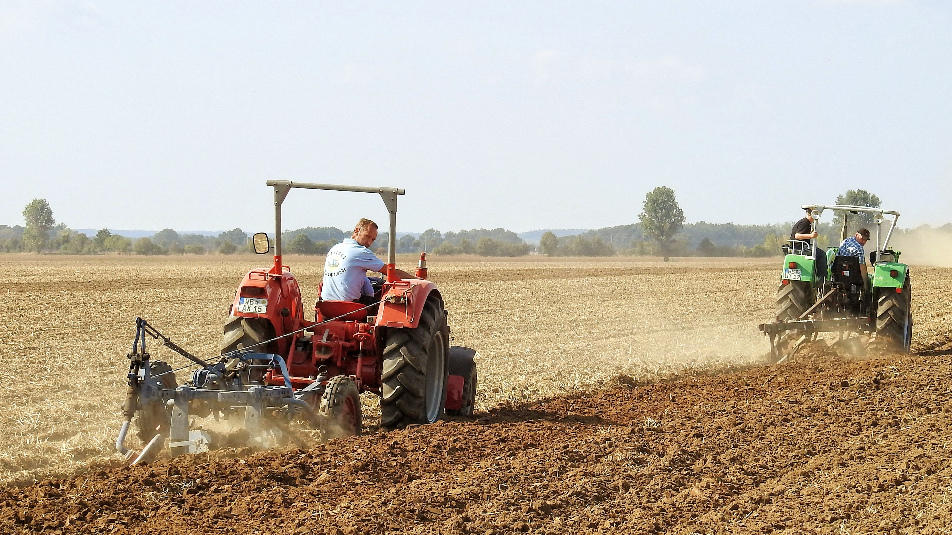


Data Collection & Features
Soil Type
Nutrients: Nitrogen (N), Phosphorus (P), Potassium (K)
Humidity
Moisture
pH Value
Rainfall
Source of Data:
Crop recommendation data: Sourced from Kaggle and agricultural websites like ICRISAT and AgroMet.
Fertilizer recommendation model: Trained on a simulated dataset, created to include valid nutrient ranges based on domain knowledge.

Slide 6
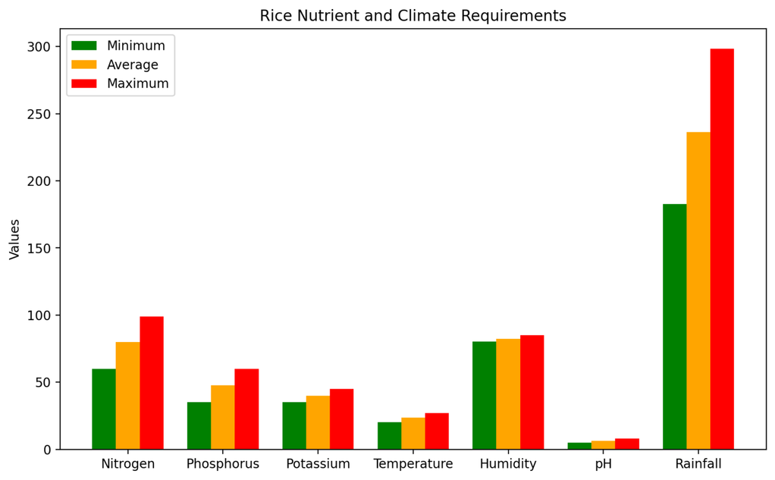
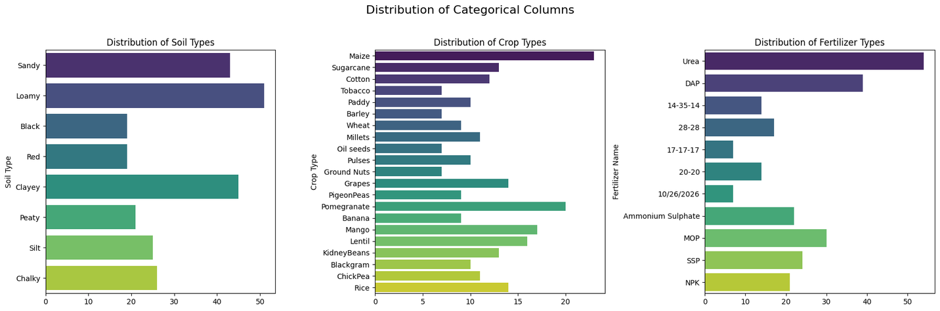
Data Analysis and Preprocessing
Exploratory Data Analysis (EDA):.
Visualizing data trends and understanding relationships.
Handling missing values, outliers, and scaling features
Data Cleaning:
Ensuring data quality for model training.

Slide 7
Model Selection and Training
Machine Learning Models Compared:
Logistic Regression (LR), Decision Trees, Random Forest (RF) and Support Vector Classifier (SVC).
Training Process:
Data Split: 80% training and 20% testing for model training and validation.
Model Training: Both models were trained and validated using the prepared dataset to optimize performance.
Final Model:
Crop Recommendation: Logistic Regression with 96% accuracy.
Fertilizer Recommendation: Random Forest with 92% accuracy.

Slide 8
Model Evaluation
Evaluation Metrics
Accuracy, Precision, Recall, F1-Score.
Model | Precision | Recall | F1-Score | Support
Crop | 0.96 | 0.96 | 0.96 | 440
Fertilizer | 0.93 | 0.95 | 0.93 | 50
Both models delivered high accuracy and consistent results, validating their effectiveness for crop and fertilizer recommendations.

Slide 9
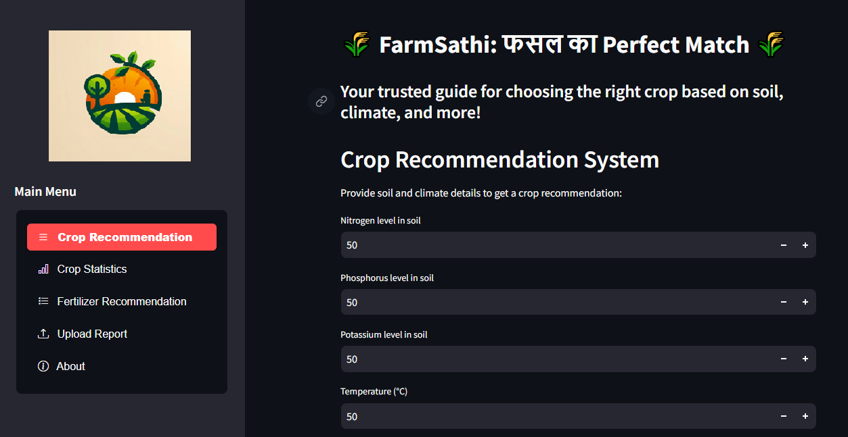
Model Deployment
Web App Deployment:
Deployed using Streamlit for easy user interaction.
Users can input environmental data and receive crop & fertilizer recommendations.
Features:
User-friendly interface.
Displaying crop recommendations and analysis based on inputs.

Slide 10
Conclusion & Future Work
Conclusion:
The system provides reliable recommendations for crop growth optimization.
Achieved high accuracy and ease of use.
Planned Enhancements
Integration of Additional Data:
Real-time weather data for dynamic recommendations.
Advanced soil analysis data.
Expanded Recommendations:
Support for more crop and fertilizer types.
Inclusion of region-specific crops and practices
Farmer Assistance Platform:
Developing a full-fledged system for comprehensive farmer support.
Features such as Crop Disease Detection and Pesticide Recommendations.

Slide 11
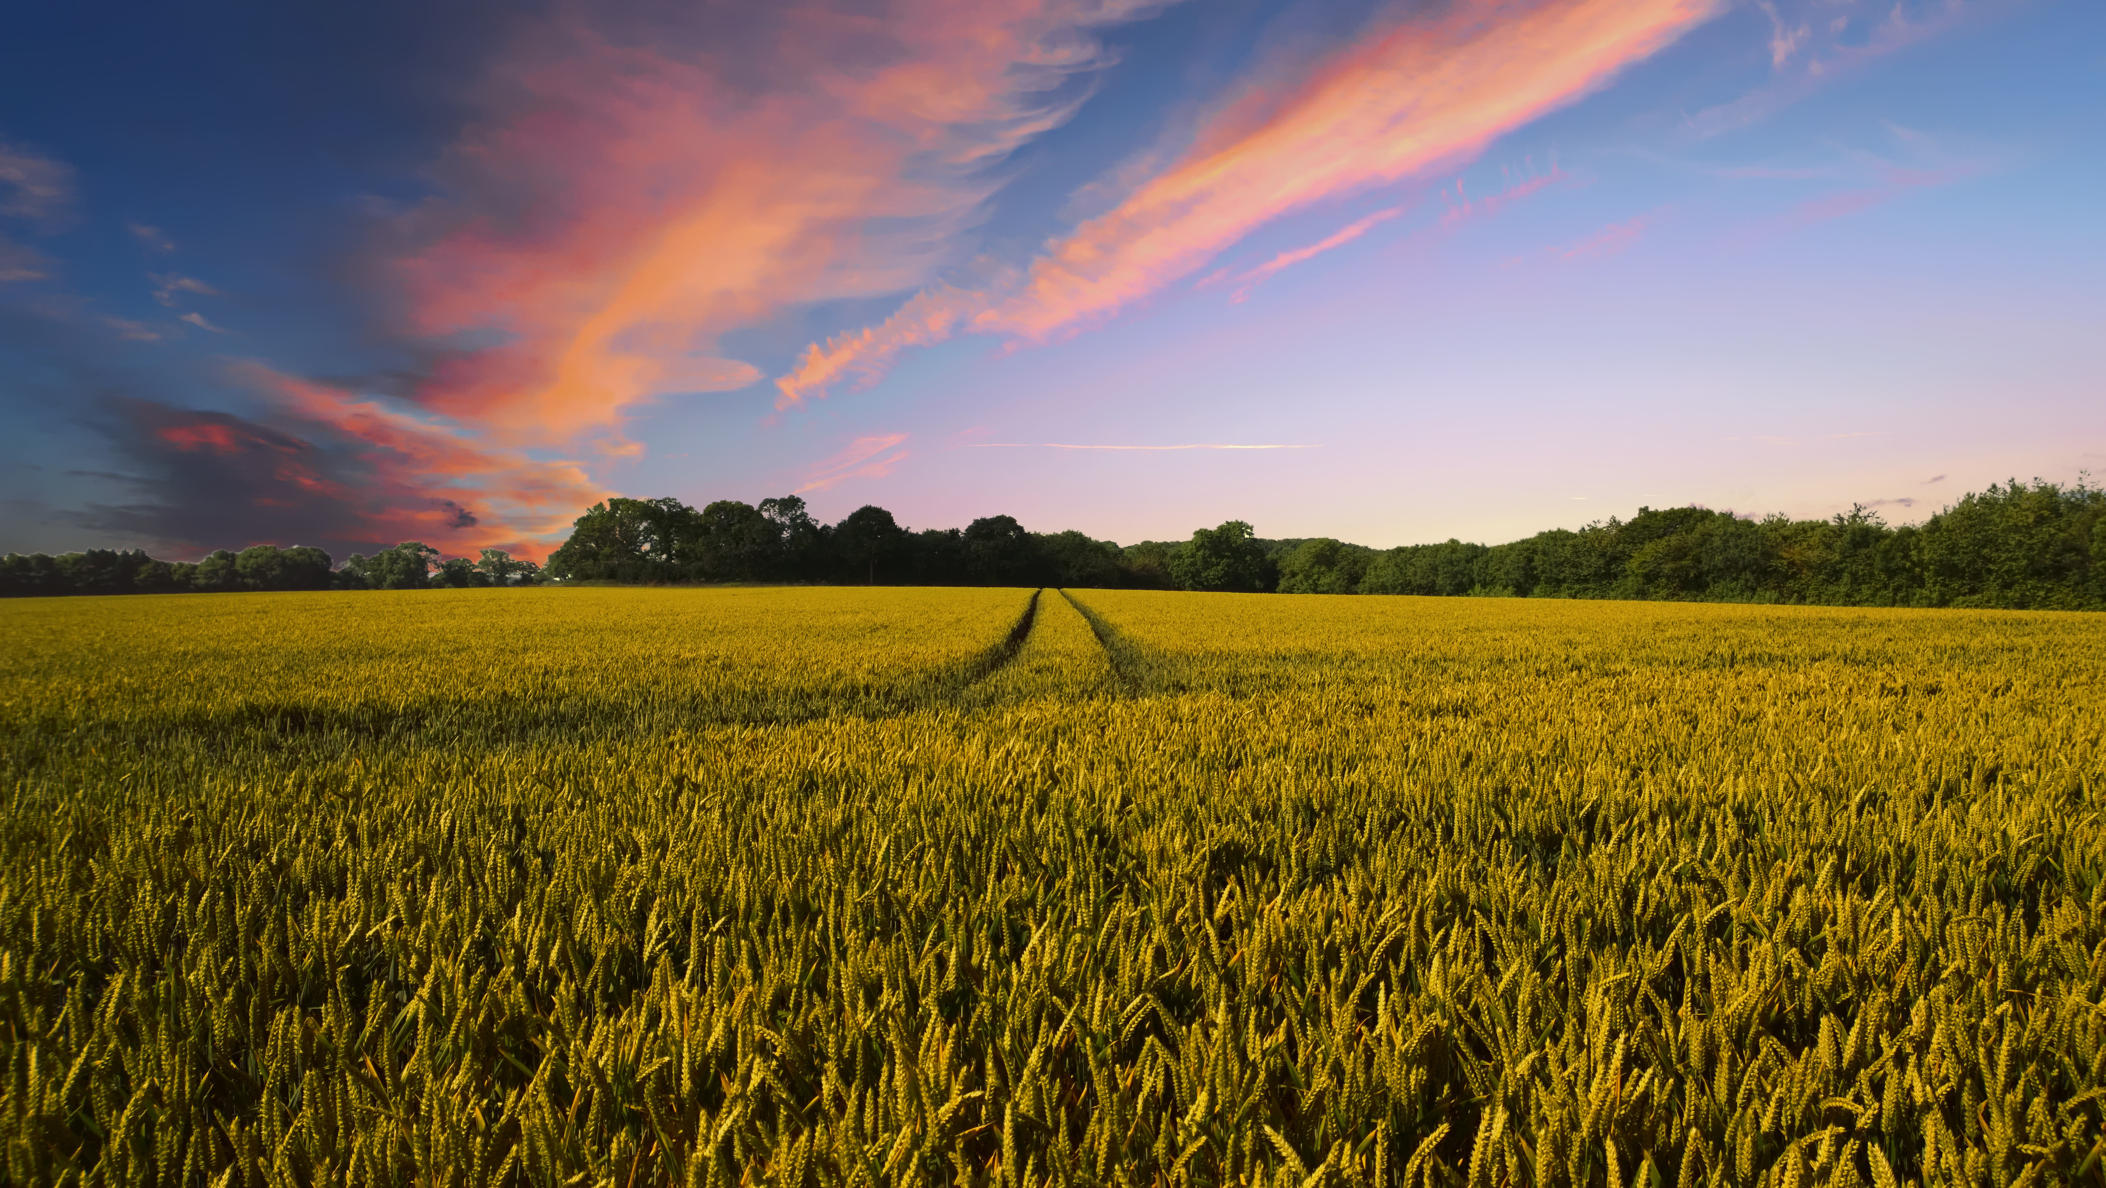

Thank You
We are open to your questions and feedback to improve further.
Feel free to ask! 😊

